Slide 1
COMBINATIONAL CIRCUITS AND ITS APPLICATIONS IN
INDUSTRY.
By Partha Pratim Dey

Slide 2
CONTENT
INTRODUCTION
WHAT IS COMINATIONAL CIRCUIT
DIFFERENT TYPES OF COMBINATIONAL CIRCUITS
ADDER (HALF & FULL)
SUBTRACTOR (HALF & FULL)
APPLICATION OF ADDER AND SUBTRACTOR
MULTIPLEXER
DE-MULTIPLEXER
APPLICATION OF MUX AND D-MUX
ENCODER
DCODER
APPLICATION OF ENCODER AND DCODER
CONCLUSION

Slide 3
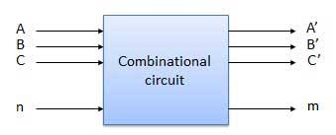
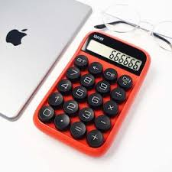
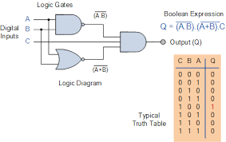
INTRODUCTION
In this PPT we are going to see what is “combinational circuits”
and its application on the industry.

Slide 4
WHAT IS COMINATIONAL CIRCUIT
Combinational circuit is a circuit in which we combine the different gates in the circuit.
Some of the characteristics of combinational circuits are following-
The combinational circuit do not use any memory. The previous state of input does not have any effect on the present state of the circuit.
For n input variables, there are 2^{n} possible binary input combinations.
For each binary combination of the input variables, there is one possible output.

Slide 5
DIFFERENT TYPES OF COMBINATIONAL CIRCUITS
Adder (Half & Full )
Subtractor (Half & Full)
Multiplexer
D-Multiplexer
Encoder
Decoder

Slide 6
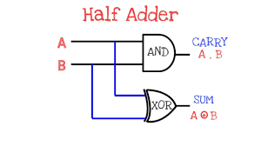
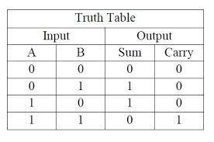
ADDER (HALF)
Half adder is a combinational logic circuit with two input (A , B) port and two output port (Sum and Carry).
Boolean Expression
Sum = A XOR B
Carry = A AND B
Circuit Diagram

Slide 7
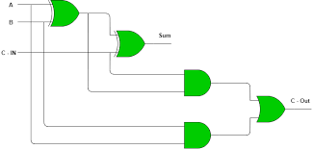
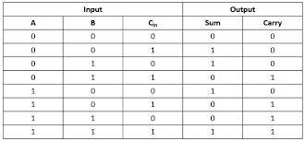
ADDER (FULL)
Full adder is a combinational logic circuit with two input (A , B ,Cin) port and two output port (Sum and Carry).
Boolean Expression
Sum = A XOR B XOR Cin
Carry = (A AND B) OR Cin(A XOR B)
Circuit Diagram
Truth Table

Slide 8

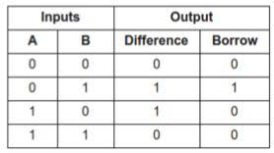
SUBTRACTOR (HALF)
A half subtractor is a logical circuit that performs a subtraction operation on two binary digits. The half subtractor produces a
difference and a borrow bit for the next stage.
Boolean Expression
Diff = X XOR Y
Borrow = not-X AND Y
Circuit Diagram
Truth Table

Slide 9
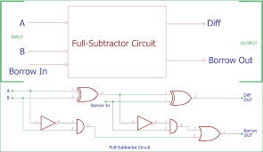
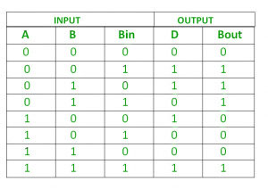
SUBTRACTOR (FULL)
The full subtractor is a combinational circuit with three inputs A,B,Bin and two output D and Bout'. A is the 'minuend', B is 'subtrahend', Bin is the 'borrow' produced by the previous stage, D is the difference output and Bout' is the borrow output.
Boolean Expression
D = (A XOR B) XOR B_{IN}
B_{OUT} = NOT A . Bin + NOT A.B + B.Bin
Circuit Diagram
Truth Table

Slide 10
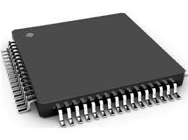
APPLCATION OF ADDDER AND SUBTRACTOR
Adder and subtractor are basically used for performing arithmetical functions like addition, subtraction in electronic calculators and digital instruments. They are also used in microcontrollers for arithmetic additions, PC (program counter) and timers.

Slide 11
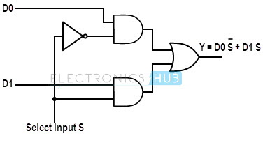
MULTIPLEXER
Multiplexer is a combinational circuit that has maximum of 2^{n} data inputs, ‘n’ selection lines and single output line. One of these data inputs will be connected to the output based on the values of selection lines.
Example– 2:1 multiplexer
Function Table
S0 | Y
0 | D0
1 | D1
Function Expression
Circuit Diagram

Slide 12
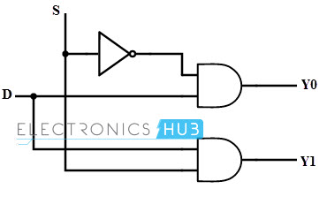
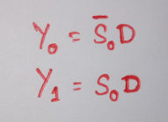
DE-MULTIPLEXER
The action or operation of a demultiplexer is opposite to that of the multiplexer. As inverse to the MUX , demux is a one-to-many circuit.
Function Table
S0 | Y1 | Y0
0 | 0 | D
1 | D | 0
Function Expression
Circuit Diagram

Slide 13
APPLICATION OF MUX & DE-MUX
Communication System -
Multiplexer-A Multiplexer is used in communication system, which has a transmission system and also a communication network. A Multiplexer is used to increase the efficiency of the communication system by allowing the transmission of data, such as audio & video data from different channels via cables and single lines.
Computer Memory – A Multiplexer is used in computer memory to keep up a vast amount of memory in the computers, and also to decrease the number of copper lines necessary to connect the memory to other parts of the computer.
Telephone Network – A multiplexer is used in telephone networks to integrate the multiple audio signals on a single line of transmission..
DE-Multiplexer - De-multiplexer receives the output signals from the multiplexer; and, at the receiver end, it converts them back to the original form
Arithmetic Logic Unit – The output of the arithmetic logic unit is fed as an input to the De-multiplexer, and the o/p of the demultiplexer is connected to a multiple registers. The output of the ALU can be stored in multiple registers.

Slide 14
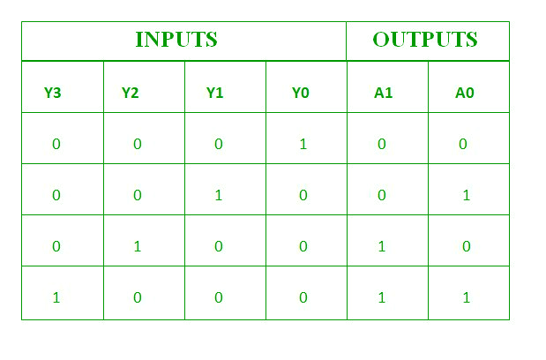
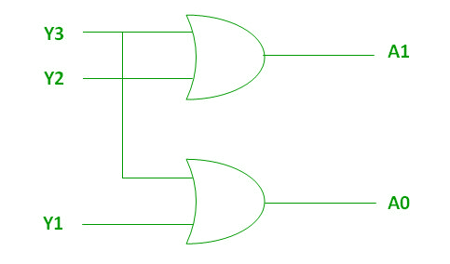
Encoder
An encoder has n number of input lines and m number of output lines. An encoder produces an m bit binary code corresponding to the digital input number. The encoder accepts an n input digital word and converts it into an m bit another digital word.
Logic Expression
A1 = Y3 + Y2
A0 = Y3 + Y1
Truth table
Circuit Diagram

Slide 15
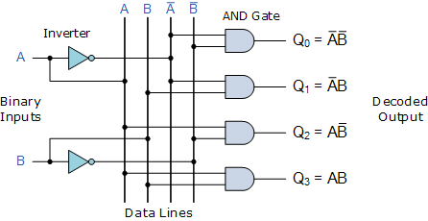
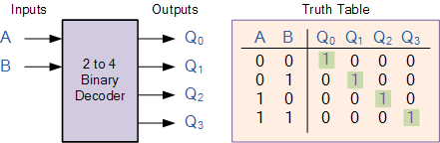
DECODER
The name “Decoder” means to translate or decode coded information from one format into another, so a binary decoder transforms “n” binary input signals into an equivalent code using 2^{n} outputs.
Circuit Diagram
&
Logic Expression
Truth Table

Slide 16
APPLICATION OF ENCODER & DECODER
Data Privacy And Security
Data Communication
Data Compression

Slide 17
CONCLUSION
So, in short combinational logic circuits surround us everywhere in our daily lives. Identify 2-3 examples of circuits that contain combinational logic that you interact with almost daily are—
Calculator
Microprocessor
Program Counter
Signal Converter

Slide 18


